Slide 1

Topic 3: Key Components of (Generalized) Linear Models
Chapter 6

Slide 2
response = deterministic part + stochastic part
deterministic also called systemic part
stochastic also called random part

Slide 3
For the description of the stochastic part of the model, we use a statistical distribution. In order to choose the “right” distribution, we need to know the typical sampling situation that leads to one rather than another distribution.
Four of the most common statistical distributions: normal, uniform, binomial, Poisson
Linear models are so called because they assume that the mean (i.e., the expected) response can be treated as the result of explanatory variables whose effects add together.

Slide 4
To be able to specify how exactly we think the explanatory variables affect the response, we need to understand the so-called linear predictor of the model, the design matrix, and different parameterizations of a linear model. It is the design matrix along with the observed values of the covariates that makes up the deterministic part of a linear statistical model.

Slide 5
Stochastic part of a linear model: Statistical distributions
Things whose outcome is affected by chance and thus are only predictable up to a certain degree are called random variables.
A probability distribution assigns to each possible realization (value or event) of a random variable a probability of occurrence.
Probability distributions are themselves governed (described) by one or a few parameters, and their actual form depends on the particular values of these parameters.

Slide 6
Among the four distributions (normal, uniform, Poisson, and binomial), one big divide is whether your response (i.e., the data) is discrete or continuous. Counts are discrete and point to the two latter distributions, while measurements are continuous and point to the two former distributions.
Under certain circumstances (e.g., large sample sizes, many observed unique values), the two discrete distributions can often be well approximated by a normal distribution. For instance, large counts in practice are often modeled as coming from a normal distribution.

Slide 7
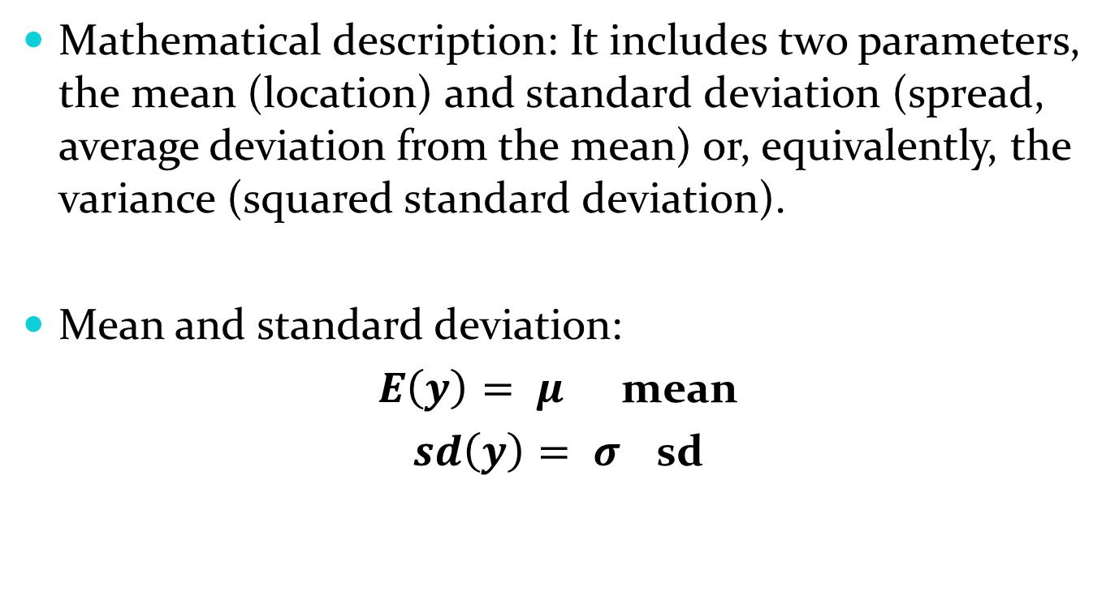
Normal distribution
Mathematical description: It includes two parameters, the mean (location) and standard deviation (spread, average deviation from the mean) or, equivalently, the variance (squared standard deviation).
Mean and standard deviation:
$E\left(y\right)= μ$ mean
$sd\left(y\right)= σ$ sd

Slide 8
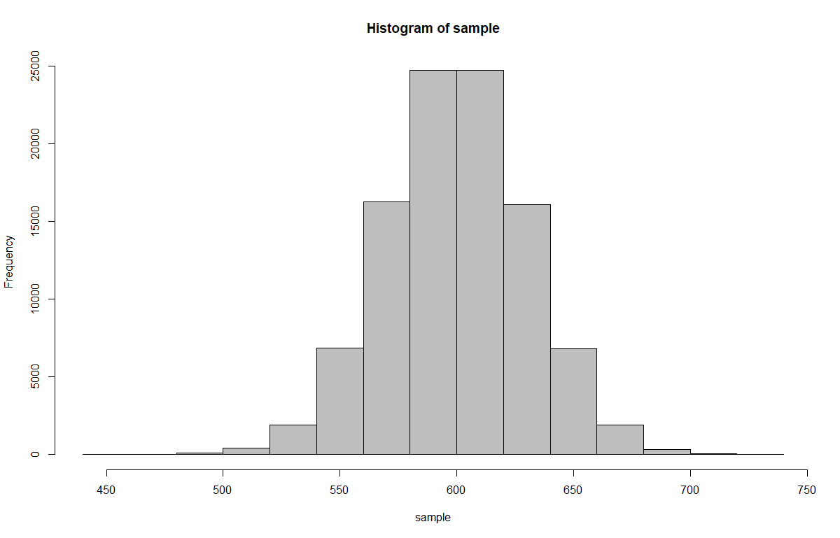
Normal distribution
n <- 100000 # Sample size
mu <- mean <- 600 # Body mass of male peregrines
sd <- st.dev <- 30 # SD of body mass of male peregrines
sample <- rnorm(n = n, mean = mu, sd = sd)
print(sample, dig = 4)
hist(sample, col = "grey")

Slide 9
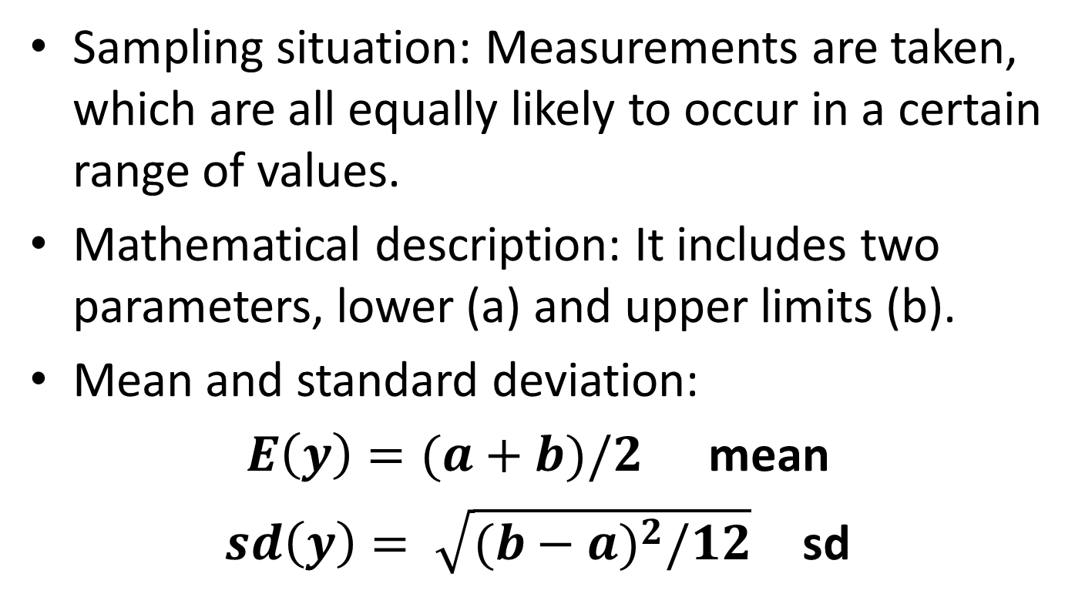
Continuous uniform distribution
Sampling situation: Measurements are taken, which are all equally likely to occur in a certain range of values.
Mathematical description: It includes two parameters, lower (a) and upper limits (b).
Mean and standard deviation:
$E\left(y\right)=(a+b)/2$ mean
$sd\left(y\right)= \sqrt{{(b−a)}^{2}/12}$ sd

Slide 10
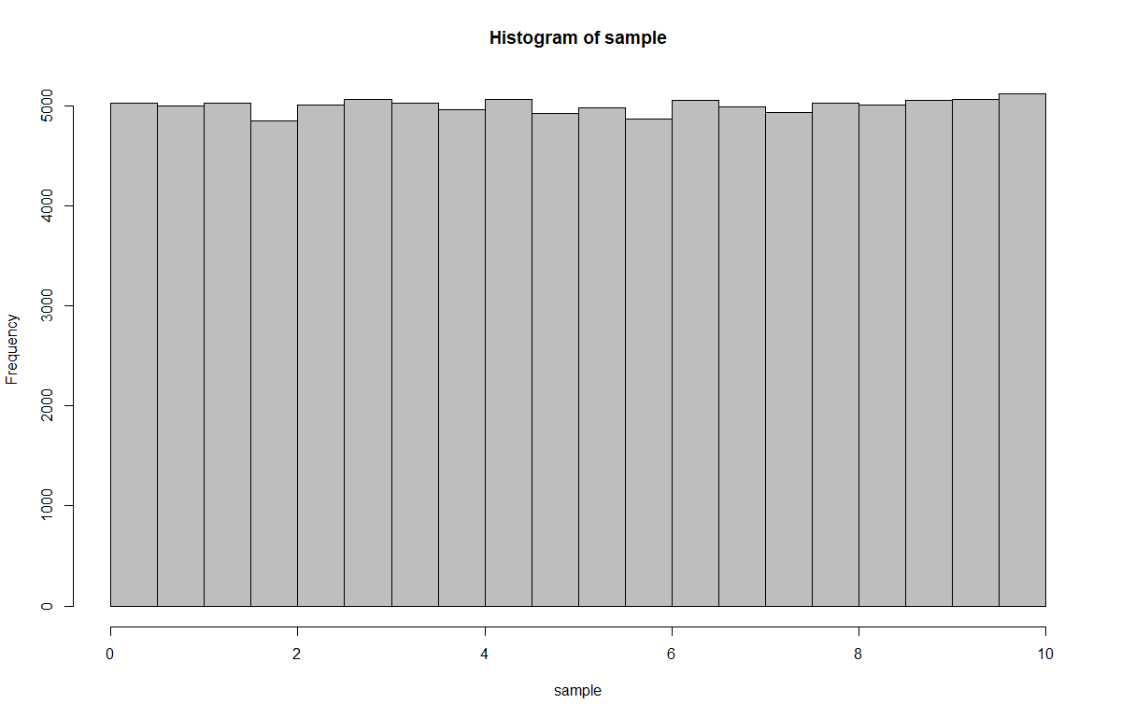
Continuous uniform distribution
n <- 100000 # Sample size
a <- lower.limit <- 0
b <- upper.limit <- 10
sample <- runif(n = n, min = a, max = b)
print(sample, dig = 3)
hist(sample, col = "grey")

Slide 11
Binomial Distribution: The “Coin-Flip Distribution”
Sampling situation: When N available things all have the same probability p of being in a certain state (e.g., being counted, or having a certain attribute, like being male or dead), then the number x that is actually counted in that sample, or has that attribute, is binomially distributed.
Classical examples: Number of males in a clutch, school class, or herd of size N; number of times heads shows up among N flips of a coin.
Varieties: The Bernoulli distribution corresponds to a single coin flip and has only a single parameter, p. Actually, a binomial is the sum of N Bernoullis (or coin flips).

Slide 12
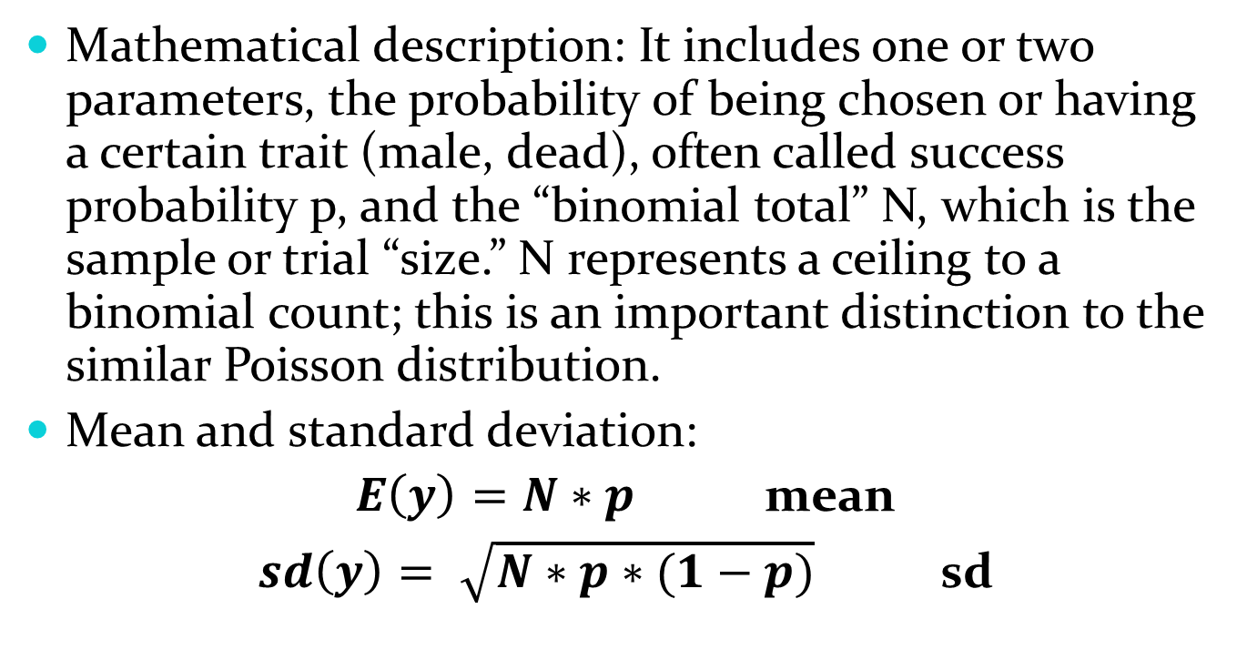
Binomial Distribution: The “Coin-Flip Distribution”
Mathematical description: It includes one or two parameters, the probability of being chosen or having a certain trait (male, dead), often called success probability p, and the “binomial total” N, which is the sample or trial “size.” N represents a ceiling to a binomial count; this is an important distinction to the similar Poisson distribution.
Mean and standard deviation:
$E\left(y\right)=N∗p$ mean
$sd\left(y\right)= \sqrt{N∗p∗(1−p)}$ sd

Slide 13
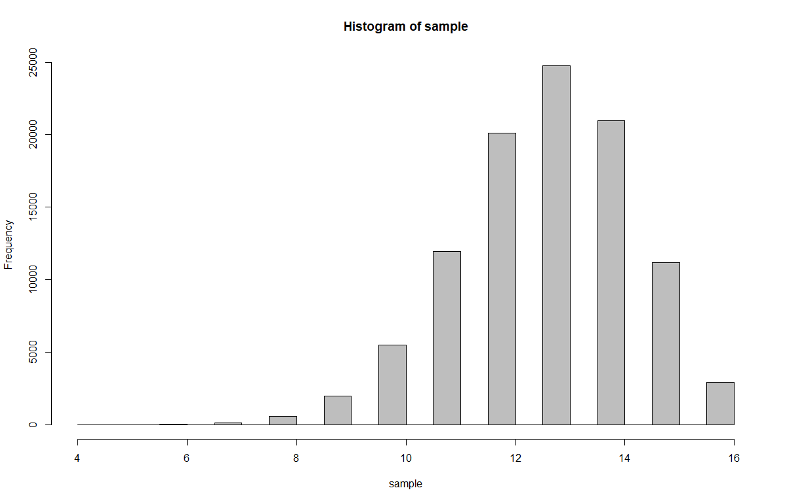
Binomial Distribution: The “Coin-Flip Distribution”
n <- 100000 # Sample size
N <- 16 # Number of individuals that flip the coin
p <- 0.8 # Probability of being counted (seen), dead or a male
sample <- rbinom(n = n, size = N, prob = p)
print(sample, dig = 3)
hist(sample, col = "grey")

Slide 14
Poisson Distribution
Sampling situation: When things (e.g., birds, cars, or erythrocytes) are randomly distributed in one or two (or more) dimensions and we randomly place a “counting window” along that dimension or in that space and record the number of things, then that number is Poisson distributed.
Classical examples: Number of passing cars during 10-min counts at a street corner; number of birds that fly by you at a migration site, and number of birds or hares per sample quadrat.

Slide 15
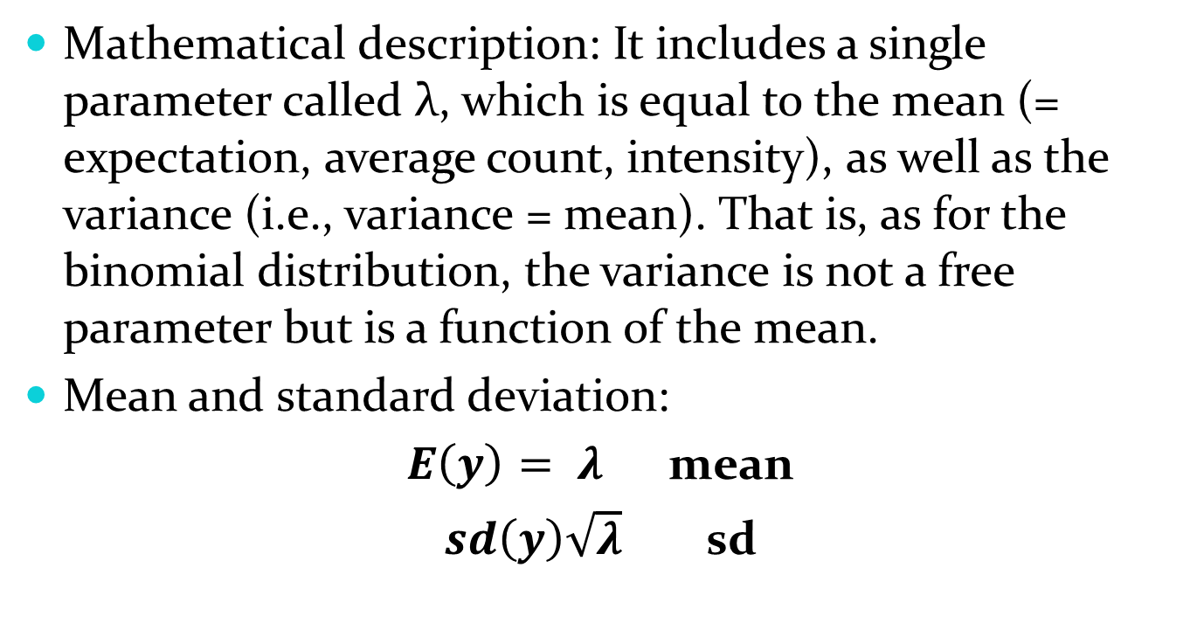
Poisson Distribution
Mathematical description: It includes a single parameter called λ, which is equal to the mean (= expectation, average count, intensity), as well as the variance (i.e., variance = mean). That is, as for the binomial distribution, the variance is not a free parameter but is a function of the mean.
Mean and standard deviation:
$E\left(y\right)= λ$ mean
$sd\left(y\right)\sqrt{λ}$ sd

Slide 16
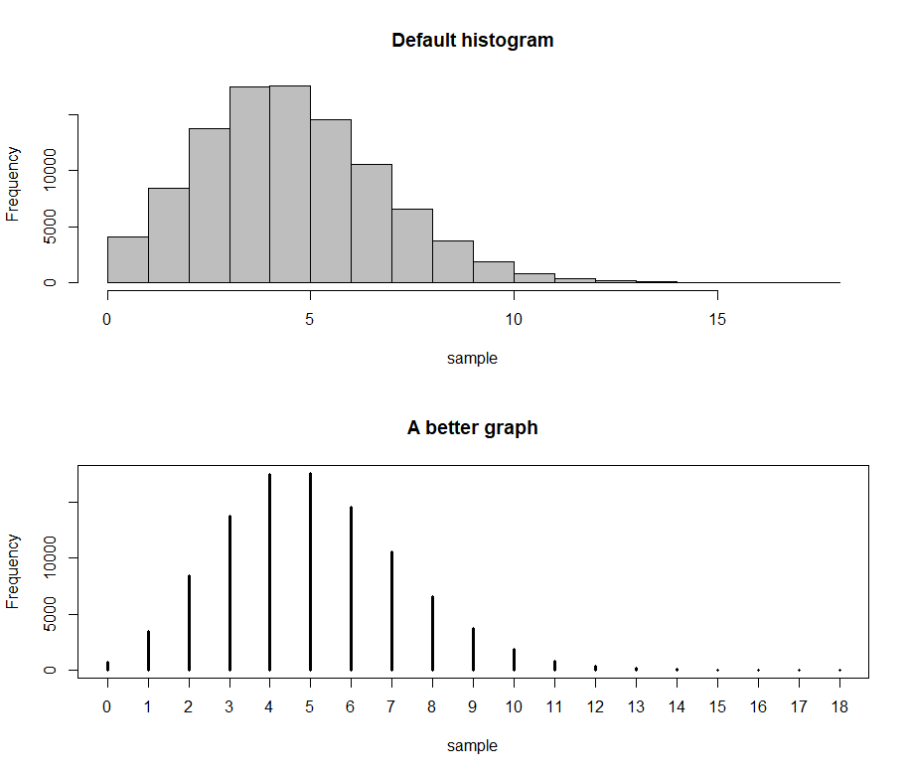
Poisson Distribution
n <- 100000 # Sample size
lambda <- 5 # Average no. individuals per sample, density
sample <- rpois(n = n, lambda = lambda)
print(sample, dig = 3)
par(mfrow = c(2,1))
hist(sample, col = "grey",
main = "Default histogram")
plot(table(sample),
main = "A better graph",
lwd = 3, ylab = "Frequency")

Slide 17
Deterministic part of linear models: linear predictors and design matrices
Linear models describe the expected response as a linear combination of the effects of discrete or continuous explanatory variables. That is, they directly specify the relationship between the response and one or more explanatory variables.

Slide 18
Design matrix
The material in the rest of this chapter may be seen by some as a nuisance. It may look difficult at first and indeed may not be totally necessary when fitting linear models using one of the widely known stats packages. However, understanding design matrices will greatly increase your grasp of statistical models in general.
For each element of the response vector, the design matrix n index indicates which effect is present for categorical (= discrete) explanatory variables and what “amount” of an effect is present in the case of continuous explanatory variables.
The design matrix contains as many columns as the fitted model has parameters, and when matrix-multiplied with the parameter vector, it yields the linear predictor, another vector.
In the remainder of this chapter, we look at a progression of typical linear models (e.g., t-test, simple linear regression, one-way ANOVA, and analysis of covariance (ANCOVA)).

Slide 19
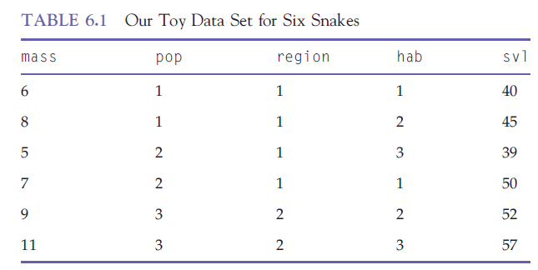
Design matrix example
six snakes; body mass (mass, in units of 10 g; a continuous response variable)
in three populations (pop)
two regions (region)
three habitat types (hab)
continuous explanatory variable snout–vent length (svl)

Slide 20

Example: model of the mean
lm(mass ~ 1)
$${\text{mass}}_{i}\text{ = }\text{μ}\text{ + }{\text{ε}}_{i}$$
$\text{μ}\text{ =}$ overall mean
${\text{ε}}_{i}$= residual for snake $i$
$${\text{ε}}_{i}\text{∼ }\text{Normal}\text{(0,}σ^{2})$$

Slide 21
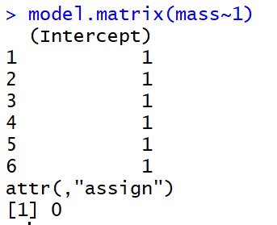
Example: model of the mean

Slide 22
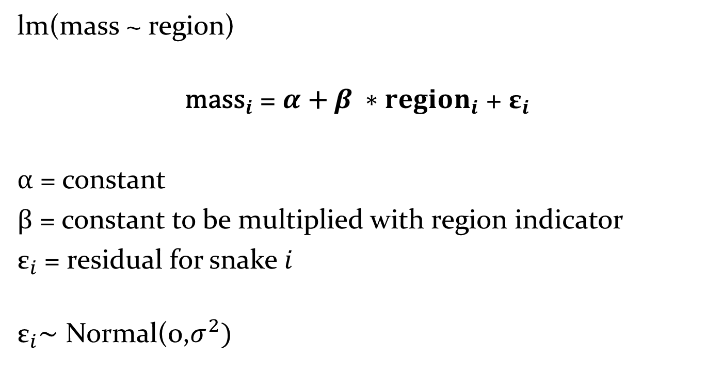
Example: t-Test
lm(mass ~ region)
$${\text{mass}}_{i}\text{ = }α\text{ + }β ∗{region}_{i}\text{ + }{\text{ε}}_{i}$$
$α\text{ =}$ constant
$β\text{ =}$ constant to be multiplied with region indicator
${\text{ε}}_{i}$= residual for snake $i$
$${\text{ε}}_{i}\text{∼ }\text{Normal}\text{(0,}σ^{2})$$

Slide 23
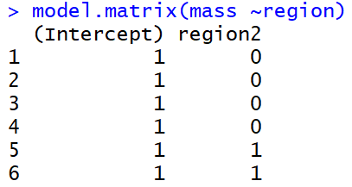
Example: t-Test

Slide 24
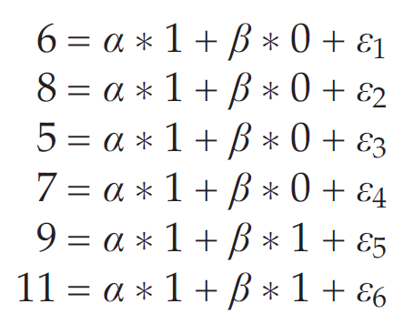
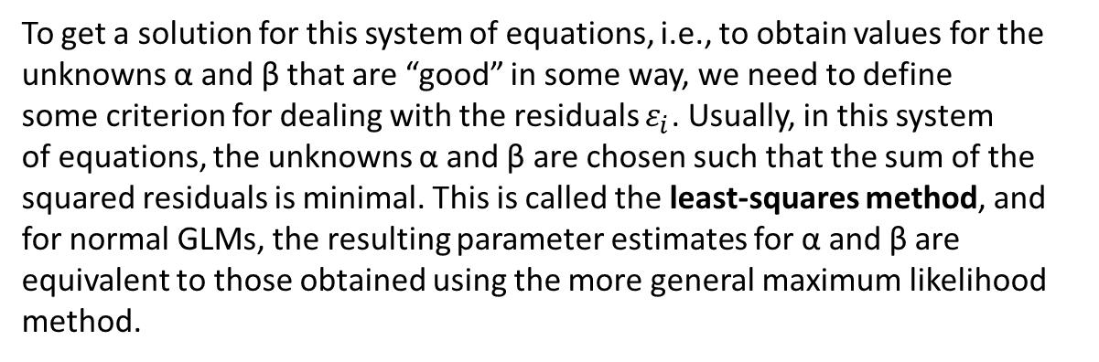
Example: t-Test
To get a solution for this system of equations, i.e., to obtain values for the
unknowns α and β that are “good” in some way, we need to define
some criterion for dealing with the residuals $ε_{i}$. Usually, in this system
of equations, the unknowns α and β are chosen such that the sum of the
squared residuals is minimal. This is called the least-squares method, and
for normal GLMs, the resulting parameter estimates for α and β are equivalent to those obtained using the more general maximum likelihood method.

Slide 25
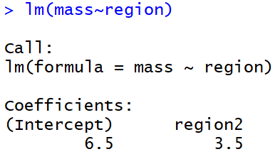
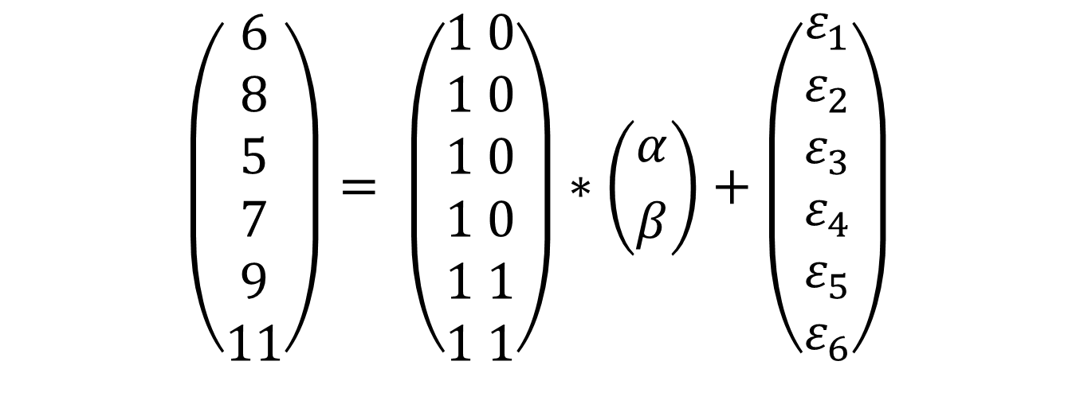
Example: t-Test
$$\left(\begin{aligned}6 \\ 8 \\ 5 \\ 7 \\ 9 \\ 11\end{aligned}\right)= \left(\begin{aligned}1 0 \\ 1 0 \\ 1 0 \\ 1 0 \\ 1 1 \\ 1 1\end{aligned}\right)∗\left({α \atop β}\right)+\left(\begin{aligned}ε_{1} \\ ε_{2} \\ ε_{3} \\ ε_{4} \\ ε_{5} \\ ε_{6}\end{aligned}\right)$$

Slide 26
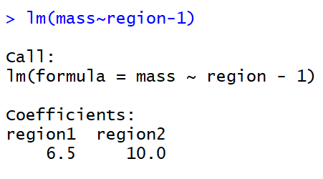
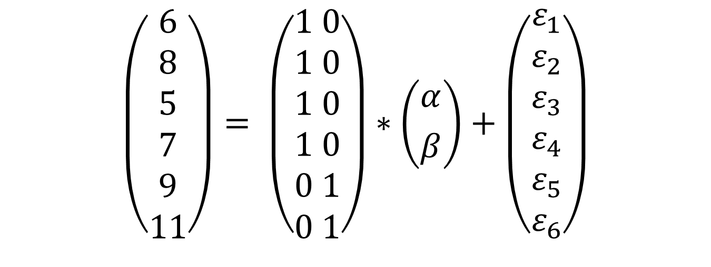
Example: t-Test (another way)
$$\left(\begin{aligned}6 \\ 8 \\ 5 \\ 7 \\ 9 \\ 11\end{aligned}\right)= \left(\begin{aligned}1 0 \\ 1 0 \\ 1 0 \\ 1 0 \\ 0 1 \\ 0 1\end{aligned}\right)∗\left({α \atop β}\right)+\left(\begin{aligned}ε_{1} \\ ε_{2} \\ ε_{3} \\ ε_{4} \\ ε_{5} \\ ε_{6}\end{aligned}\right)$$

Slide 27
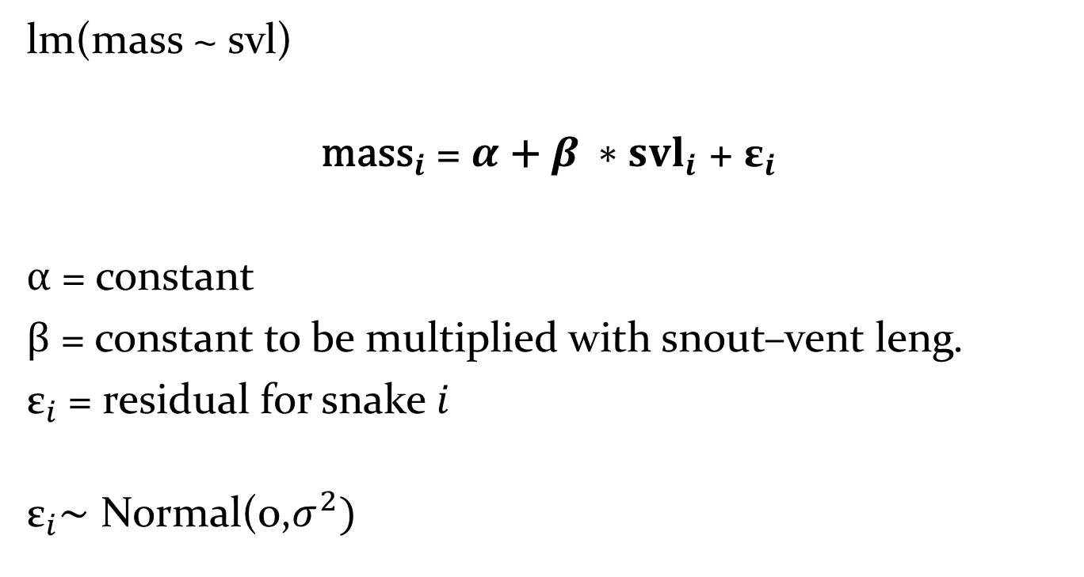
Example: simple linear regression
lm(mass ~ svl)
$${\text{mass}}_{i}\text{ = }α\text{ + }β ∗{svl}_{i}\text{ + }{\text{ε}}_{i}$$
$α\text{ =}$ constant
$β\text{ =}$ constant to be multiplied with snout–vent leng.
${\text{ε}}_{i}$= residual for snake $i$
$${\text{ε}}_{i}\text{∼ }\text{Normal}\text{(0,}σ^{2})$$

Slide 28
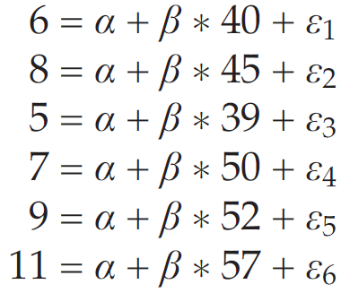
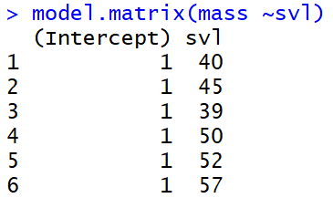
Example: simple linear regression

Slide 29
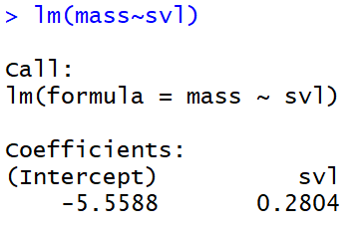
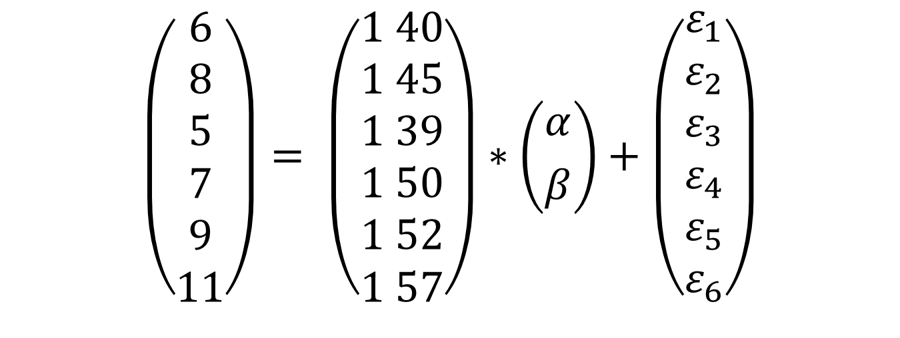
Example: simple linear regression
$$\left(\begin{aligned}6 \\ 8 \\ 5 \\ 7 \\ 9 \\ 11\end{aligned}\right)= \left(\begin{aligned}1 40 \\ 1 45 \\ 1 39 \\ 1 50 \\ 1 52 \\ 1 57\end{aligned}\right)∗\left({α \atop β}\right)+\left(\begin{aligned}ε_{1} \\ ε_{2} \\ ε_{3} \\ ε_{4} \\ ε_{5} \\ ε_{6}\end{aligned}\right)$$

Slide 30
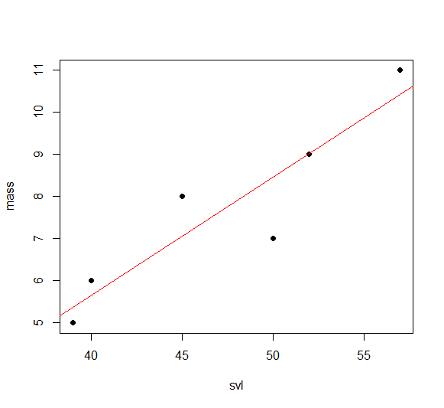
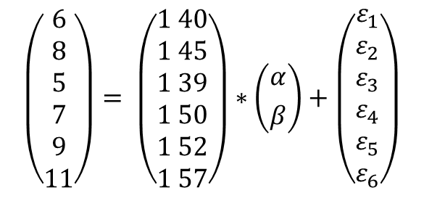



Example: simple linear regression
$$\left(\begin{aligned}6 \\ 8 \\ 5 \\ 7 \\ 9 \\ 11\end{aligned}\right)= \left(\begin{aligned}1 40 \\ 1 45 \\ 1 39 \\ 1 50 \\ 1 52 \\ 1 57\end{aligned}\right)∗\left({α \atop β}\right)+\left(\begin{aligned}ε_{1} \\ ε_{2} \\ ε_{3} \\ ε_{4} \\ ε_{5} \\ ε_{6}\end{aligned}\right)$$
$$ε_{6}$$
$$ε_{2}$$
$$ε_{4}$$

Slide 31
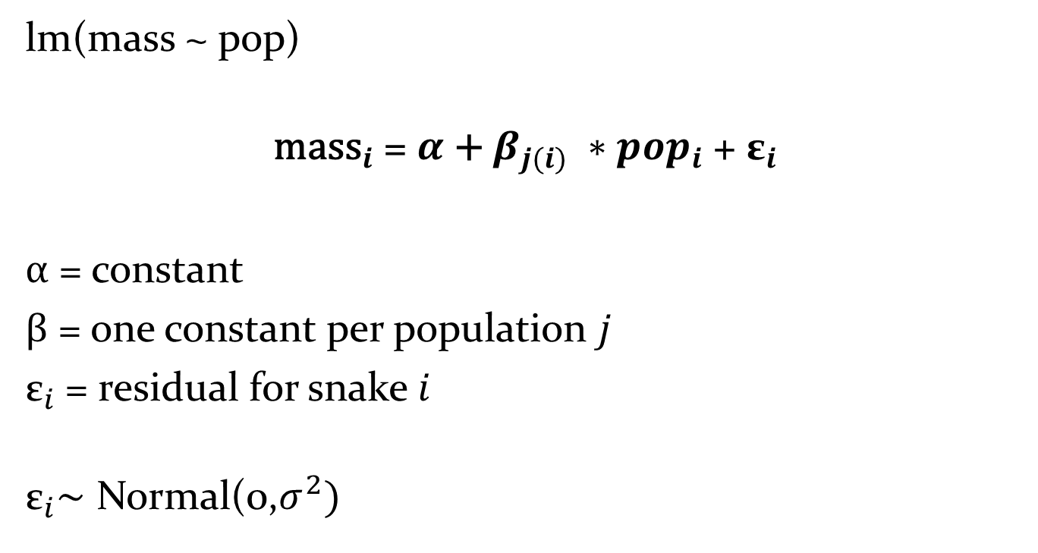
Example: One-way analysis of Variance
lm(mass ~ pop)
$${\text{mass}}_{i}\text{ = }α\text{ + }β_{j(i)} ∗{pop}_{i}\text{ + }{\text{ε}}_{i}$$
$α\text{ =}$ constant
$β\text{ =}$ one constant per population $j$
${\text{ε}}_{i}$= residual for snake $i$
$${\text{ε}}_{i}\text{∼ }\text{Normal}\text{(0,}σ^{2})$$

Slide 32
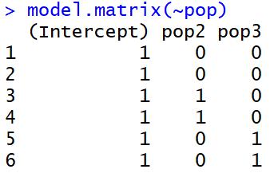
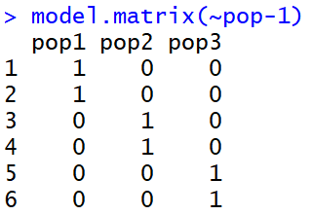
Example: One-way analysis of Variance

Slide 33
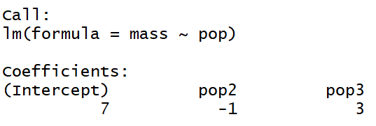
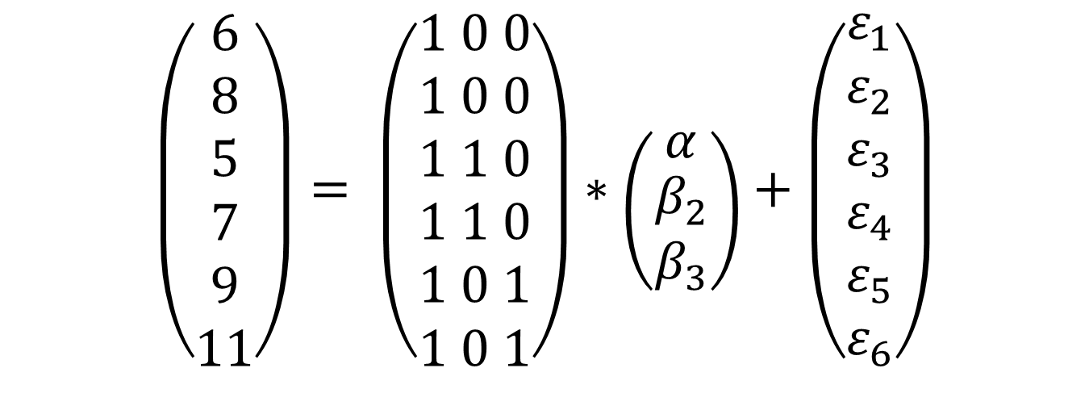
Example: One-way analysis of Variance
$$\left(\begin{aligned}6 \\ 8 \\ 5 \\ 7 \\ 9 \\ 11\end{aligned}\right)= \left(\begin{aligned}1 0 0 \\ 1 0 0 \\ 1 1 0 \\ 1 1 0 \\ 1 0 1 \\ 1 0 1\end{aligned}\right)∗\left({α \atop \begin{aligned}β_{2} \\ β_{3}\end{aligned}}\right)+\left(\begin{aligned}ε_{1} \\ ε_{2} \\ ε_{3} \\ ε_{4} \\ ε_{5} \\ ε_{6}\end{aligned}\right)$$

Slide 34
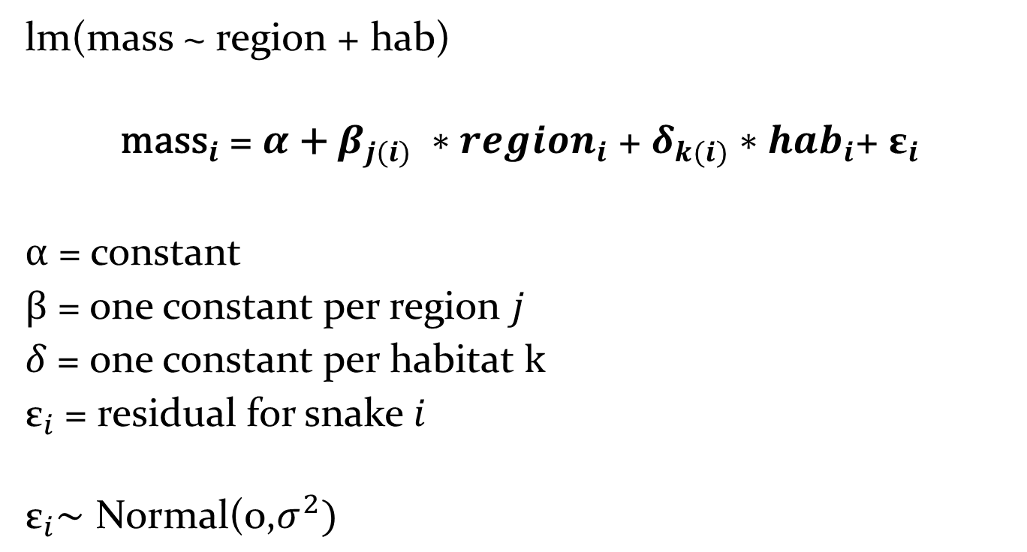
Example: Two-way analysis of Variance
lm(mass ~ region + hab)
$${\text{mass}}_{i}\text{ = }α\text{ + }β_{j(i)} ∗{region}_{i} \text{+ }δ_{k(i)}∗{hab}_{i}\text{+ }{\text{ε}}_{i}$$
$α\text{ =}$ constant
$β\text{ =}$ one constant per region $j$
$δ\text{ =}$ one constant per habitat $k$
${\text{ε}}_{i}$= residual for snake $i$
$${\text{ε}}_{i}\text{∼ }\text{Normal}\text{(0,}σ^{2})$$

Slide 35
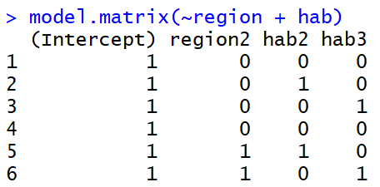
Example: Two-way analysis of Variance
$${\text{mass}}_{i}\text{ = }α\text{ + }β_{j(i)} ∗{region}_{i} \text{+ }δ_{k(i)}∗{hab}_{i}\text{+ }{\text{ε}}_{i}$$

Slide 36
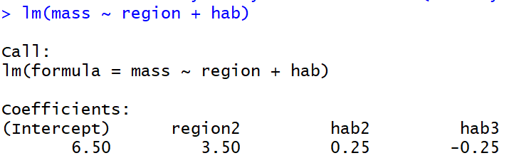
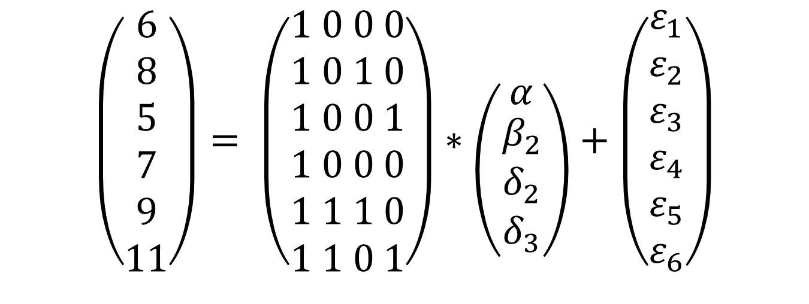
Example: Two-way analysis of Variance
$$\left(\begin{aligned}6 \\ 8 \\ 5 \\ 7 \\ 9 \\ 11\end{aligned}\right)= \left(\begin{aligned}1 0 0 0 \\ 1 0 1 0 \\ 1 0 0 1 \\ 1 0 0 0 \\ 1 1 1 0 \\ 1 1 0 1\end{aligned}\right)∗\left({α \atop \begin{aligned}β_{2} \\ δ_{2} \\ δ_{3}\end{aligned}}\right)+\left(\begin{aligned}ε_{1} \\ ε_{2} \\ ε_{3} \\ ε_{4} \\ ε_{5} \\ ε_{6}\end{aligned}\right)$$

Slide 37
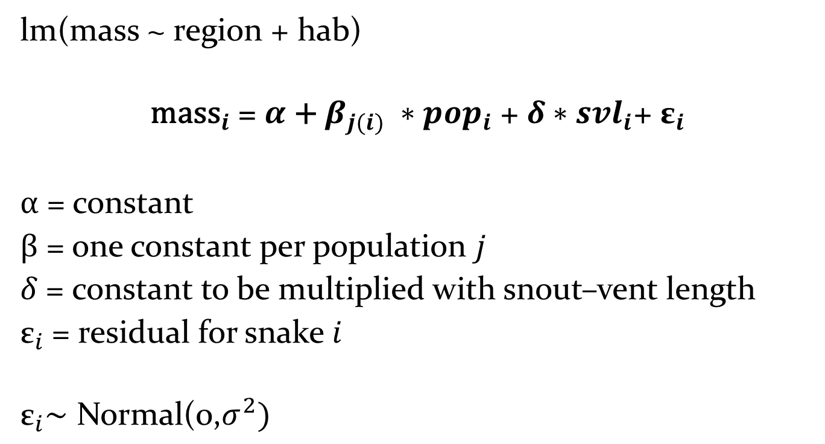
Example: Analysis of Covariance
lm(mass ~ region + hab)
$${\text{mass}}_{i}\text{ = }α\text{ + }β_{j(i)} ∗{pop}_{i} \text{+ }δ∗{svl}_{i}\text{+ }{\text{ε}}_{i}$$
$α\text{ =}$ constant
$β\text{ =}$ one constant per population $j$
$δ\text{ =}$ constant to be multiplied with snout–vent length
${\text{ε}}_{i}$= residual for snake $i$
$${\text{ε}}_{i}\text{∼ }\text{Normal}\text{(0,}σ^{2})$$

Slide 38
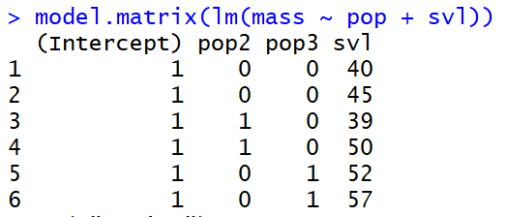
Example: Analysis of Covariance
$${\text{mass}}_{i}\text{ = }α\text{ + }β_{j(i)} ∗{pop}_{i} \text{+ }δ∗{svl}_{i}\text{+ }{\text{ε}}_{i}$$

Slide 39
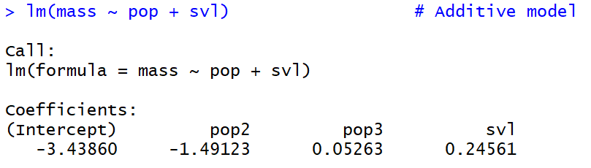
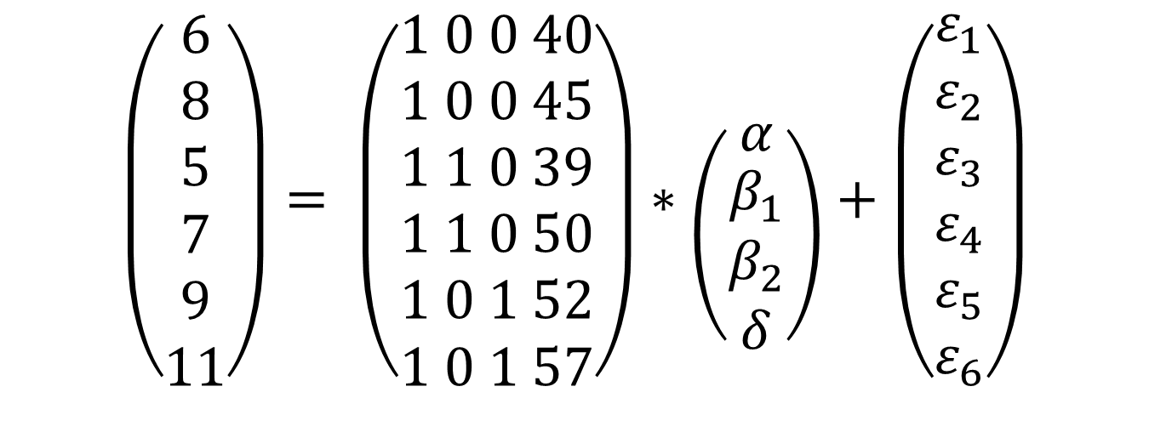
Example: Analysis of Covariance
$$\left(\begin{aligned}6 \\ 8 \\ 5 \\ 7 \\ 9 \\ 11\end{aligned}\right)= \left(\begin{aligned}1 0 0 40 \\ 1 0 0 45 \\ 1 1 0 39 \\ 1 1 0 50 \\ 1 0 1 52 \\ 1 0 1 57\end{aligned}\right)∗\left({α \atop \begin{aligned}β_{1} \\ β_{2} \\ δ\end{aligned}}\right)+\left(\begin{aligned}ε_{1} \\ ε_{2} \\ ε_{3} \\ ε_{4} \\ ε_{5} \\ ε_{6}\end{aligned}\right)$$

Slide 40
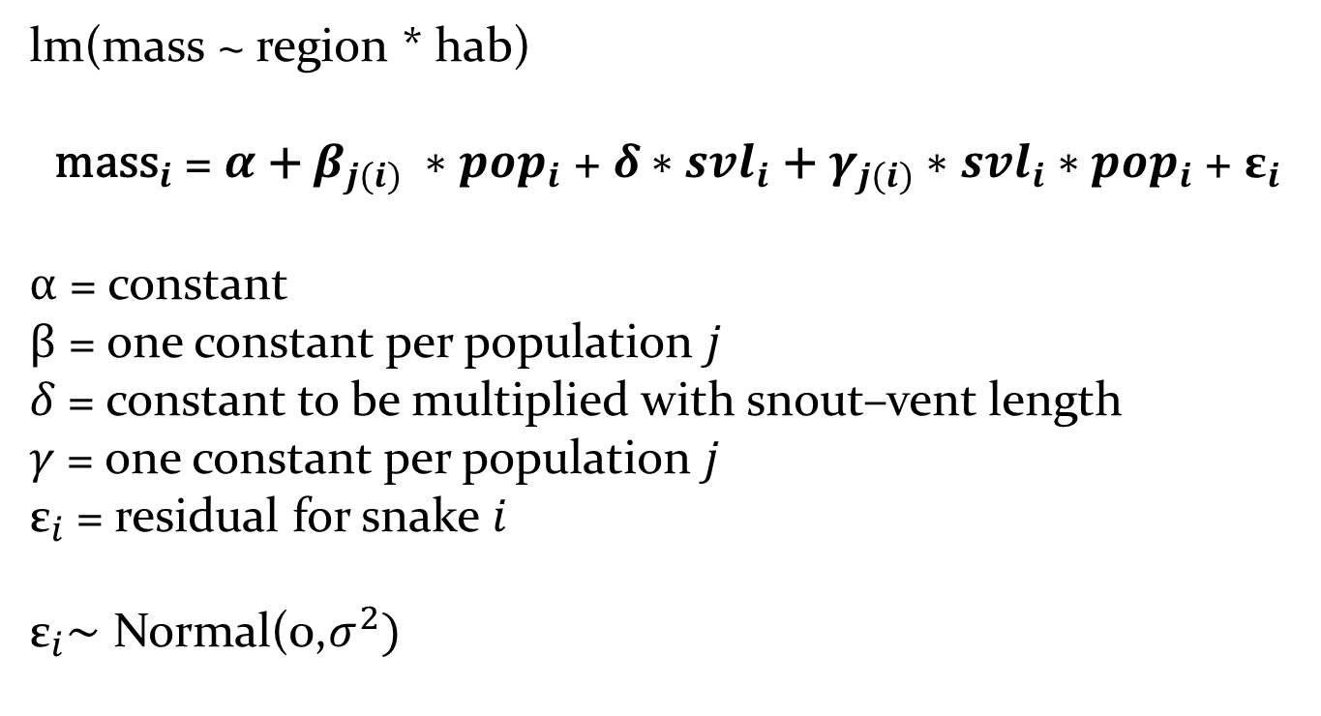
Example: Analysis of Covariance (Interaction)
lm(mass ~ region * hab)
$${\text{mass}}_{i}\text{ = }α\text{ + }β_{j(i)} ∗{pop}_{i} \text{+ }δ∗{svl}_{i}\text{ + }γ_{j(i)}∗{svl}_{i}∗{pop}_{i} \text{+ }{\text{ε}}_{i}$$
$α\text{ =}$ constant
$β\text{ =}$ one constant per population $j$
$δ\text{ =}$ constant to be multiplied with snout–vent length
$γ\text{ =}$ one constant per population $j$
${\text{ε}}_{i}$= residual for snake $i$
$${\text{ε}}_{i}\text{∼ }\text{Normal}\text{(0,}σ^{2})$$

Slide 41
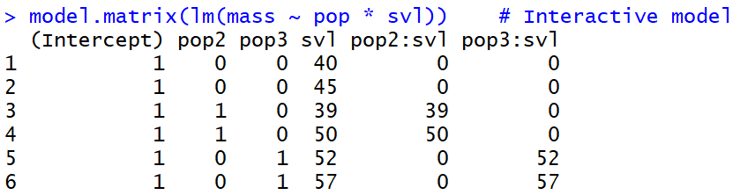
Example: Analysis of Covariance (Interaction)
$${\text{mass}}_{i}\text{ = }α\text{ + }β_{j(i)} ∗{pop}_{i} \text{+ }δ∗{svl}_{i}\text{ + }γ_{j(i)}∗{svl}_{i}∗{pop}_{i} \text{+ }{\text{ε}}_{i}$$

Slide 42
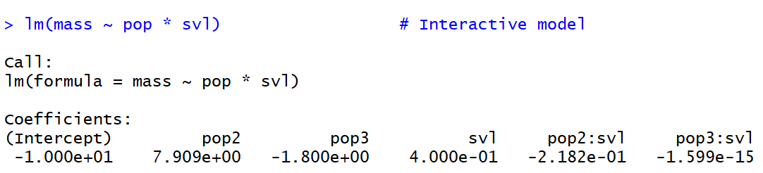
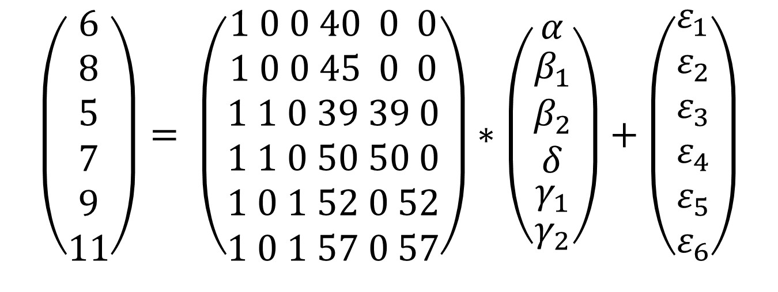
Example: Analysis of Covariance (Interaction)
$$\left(\begin{aligned}6 \\ 8 \\ 5 \\ 7 \\ 9 \\ 11\end{aligned}\right)= \left(\begin{aligned}1 0 0 40 0 0 \\ 1 0 0 45 0 0 \\ 1 1 0 39 39 0 \\ 1 1 0 50 50 0 \\ 1 0 1 52 0 52 \\ 1 0 1 57 0 57\end{aligned}\right)∗\left(\begin{aligned}\begin{aligned}{α \atop \begin{aligned}β_{1} \\ β_{2} \\ δ\end{aligned}} \\ γ_{1}\end{aligned} \\ γ_{2}\end{aligned}\right)+\left(\begin{aligned}ε_{1} \\ ε_{2} \\ ε_{3} \\ ε_{4} \\ ε_{5} \\ ε_{6}\end{aligned}\right)$$

Slide 43
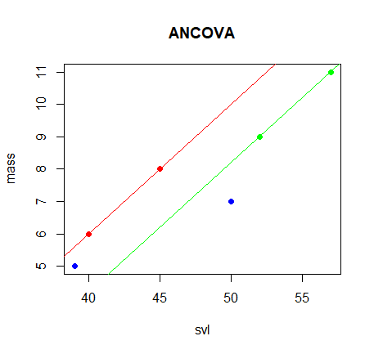
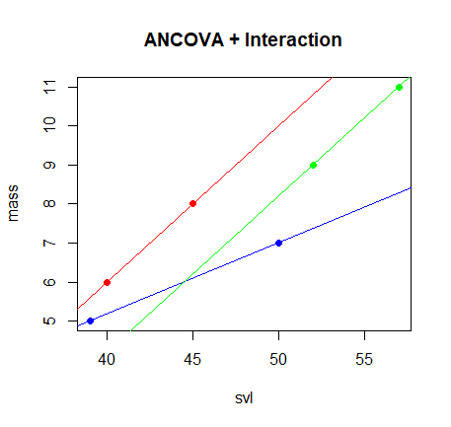
Example: Analysis of Covariance

Slide 44
Summary
Briefly reviewed the two key components of linear statistical models:
Statistical distributions
Linear predictor = design matrix * parameter vector
Understanding both is essential for applied statistics.

